Slide 1
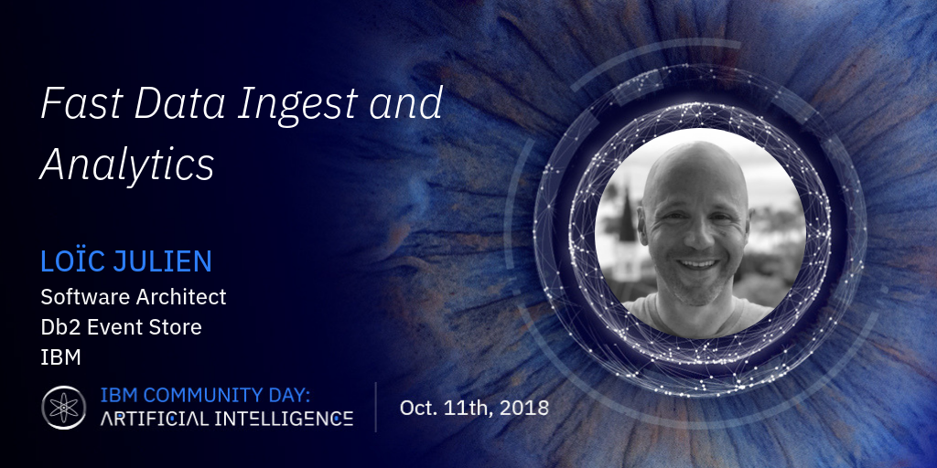

Slide 2

Fast Data Ingest & Analytics
IBM Community Day / Oct. 11, 2018
@loicjulien
IBM Developer

Slide 3
Notices and disclaimers
© 2018 International Business Machines Corporation. No part of this document may be reproduced or transmitted in any form without written permission from IBM.
U.S. Government Users Restricted Rights — use, duplication or disclosure restricted by GSA ADP Schedule Contract with IBM.
Information in these presentations (including information relating to products that have not yet been announced by IBM) has been reviewed for accuracy as of the date of initial publication and could include unintentional technical or typographical errors. IBM shall have no responsibility to update this information. This document is distributed “as is” without any warranty, either express or implied. In no event, shall IBM be liable for any damage arising from the use of this information, including but not limited to, loss of data, business interruption, loss of profit or loss of opportunity. IBM products and services are warranted per the terms and conditions of the agreements under which they are provided.
IBM products are manufactured from new parts or new and used parts. In some cases, a product may not be new and may have been previously installed. Regardless, our warranty terms apply.”
Any statements regarding IBM's future direction, intent or product plans are subject to change or withdrawal without notice.
Performance data contained herein was generally obtained in a controlled, isolated environments. Customer examples are presented as illustrations of how those
customers have used IBM products and the results they may have achieved. Actual performance, cost, savings or other results in other operating environments may vary.
References in this document to IBM products, programs, or services does not imply that IBM intends to make such products, programs or services available in all countries in which IBM operates or does business.
Workshops, sessions and associated materials may have been prepared by independent session speakers, and do not necessarily reflect the views of IBM. All materials and discussions are provided for informational purposes only, and are neither intended to, nor shall constitute legal or other guidance or advice to any individual participant or their specific situation.
It is the customer’s responsibility to insure its own compliance with legal requirements and to obtain advice of competent legal counsel as to the identification and interpretation of any relevant laws and regulatory requirements that may affect the customer’s business and any actions the customer may need to take to comply with such laws. IBM does not provide legal advice or represent or warrant that its services or products will ensure that the customer follows any law.
IBM Community Day / Oct. 11, 2018 / © 2018 IBM Corporation

Slide 4
What is Fast Data?
Fast Data is the application of big data analytics to large data sets, in real-time or near real-time, to solve a problem or create business value.
Fast Data poses several challenges:
Data is arriving faster than ever before
Billions of data events are generated every day
Data must be landed quickly, or thrown away
Data is useless without fast insights
Data value decays rapidly over time
Insights must be derived quickly
Data must be stored and shared efficiently
Large data sets require cost effective storage
Data must be available to entire organization without requiring replication
Platform must be always available
If ingest stops, data could be lost forever
Interruption in fast insights results in sub-optimal business decisions

Slide 5


Fast Data in Practice – Financial fraud detection
Millions of financial transactions every hour, only a tiny fraction of which are fraudulent
Fraud detection requires connecting multiple transactions, often over several days
Opportunity:
Preventing fraud before it occurs avoids costly efforts to reclaim lost capital
Credit card fraud losses equal $22.8 B a year (Nilson Report 2017)
Challenges:
Data volume and velocity is large
Fraud must be detected quickly, accurately, and intelligently
Needs:
Store large volumes of data quickly and reliably
Create accurate fraud detection models which can evolve as fraudsters adapt
Score models on fast data to prevent fraud before it happens
Notes:
https://nilsonreport.com/upload/content_promo/The_Nilson_Report_Issue_1118.pdf

Slide 6


Fast Data in Practice – Capacity management
Telecom networks are expensive to build and maintain
Any unused capacity is revenue lost forever
Opportunity:
Detect when networks are below capacity and launch campaign to target local businesses
Monitor and track network growth to grow capacity before users complain
Challenges:
Network data must be tracked at several levels to be useful – High data volume
Prediction must be accurate or unnecessary growth will occur
Needs:
Store high volume network data at multiple levels of granularity
Leverage deep learning to accurately predict future requirements in time to build out additional capacity

Slide 7

Event Based Systems Require a Different Approach to Data Processing and Analytics
Perishability
Data’s most valuable within a sub second to seconds of creation
Volume
Event Driven systems are driven by 100’s to Millions of Events per second with varying payload volume
Processing with Intelligence
As fast as events occur they need to be processed or acted upon requiring automated intelligence
Manageable Linear Scale
Scale Linearly with Business activity growth
Open Access
Access to data from multiple tools , Services

Slide 8
The Business World Is Evolving to Become More Event Driven
Event driven application architectures are attractive to businesses
More agile to business needs
Lower cost to change or evolve as business demands
Webscale elasticity to meet business demands globally
Event driven apps are driving changes in IT
More elastic flexible application platforms
Micro service based systems
New databases to manage large / faster volumes of data
Real time analytics / machine learning
IBM Community Day / Oct. 11, 2018 / © 2018 IBM Corporation
Notes:
The Market is beginning to embrace Event driven Application design to support new emerging applications that are driven by Events.
These Applications range from IoT solutions to , Payments, Logistics, Web Commerce and many more. These systems generate large volumes of “Events” which need to be handled in real time and historically.
These applications ae more flexible and Adaptable to new Business requirements which enable them the easily scale and change with changing business needs over time.
Thy are being built on new Elastic Scale application platforms using micro services and while these enable the applications to scale the Database Needs to scale also and provide not only operational scale and performance but real time Analytics also.

Slide 9
Architectural Landscape
IBM Community Day / Oct. 11, 2018 / © 2018 IBM Corporation

Slide 10



Events vs. Transactions
Transactions
Transactions are made up of on or more events that within the context of an application change state of that application
Transactional systems use database schema’s to define context and insert / update / deletes to define change of state
Events
Events are simply a record of something happening
In Event systems they are simply logged and left up to the application to determine state
IBM Community Day / Oct. 11, 2018 / © 2018 IBM Corporation
Notes:
Events and Transactions are Uniquely Different in how you manage them.
Transactions
Transactions are one or more Events that that change the state of an application.
In transactional systems this recorded is recorded as a set of updates, inserts or deletes in a synchronized set of operations.
Events
Events are simply records of something happening. In an Event database they are simply logged in a table.
When context is applied by an application, the application itself determines the state of a system and does not rely on the database to manage this.
This gives developers flexibility to extend and adapt applications over time without having to define all context up from in the initial Application

Slide 11
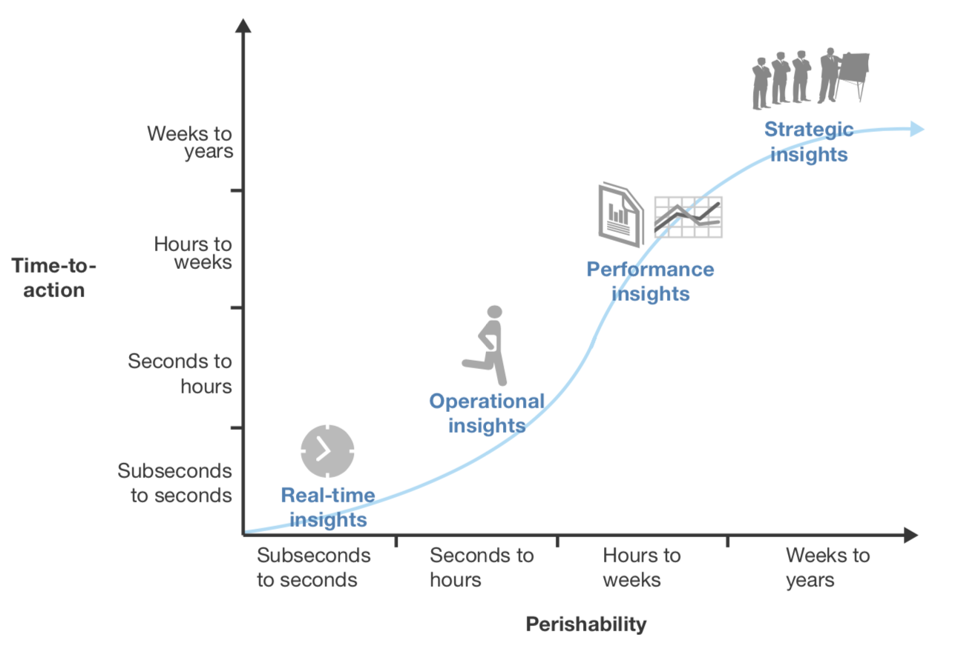
Perishable Insights: Insights That Are Actionable
Source: Forrester Perishable Insights-Stop Wasting Money on Unactionable Insights Report 2016
Being able to act on insights in real-time can provide maximum differentiation and value to businesses
To act on real time events, businesses need an Application Architecture that can ingest, analyze and act upon events as they happen in sub-second to seconds response time
Machine Learning combined with Reactive Programing frame works enable insights to be actioned automatically and stay current so business can react to events in sub-second timer frames
IBM Community Day / Oct. 11, 2018 / © 2018 IBM Corporation

Slide 12
Achieving Actionable Insight
Action
Monitor and
Manage
Speed of Business Analysis and Processing
Self Learning Analytics
Elastically Scalable Application Platform
Zero Latency Hybrid Data Platform
Business Process
High Speed
Trans-Analytical
Database
Machine
Learning
Real Time Insight
IBM Community Day / Oct. 11, 2018 / © 2018 IBM Corporation

Slide 13
Supporting the Data Demands of Actionable Insight
Complex Lambda
Style Architectures
Next Gen Platform for Real Time Analytics
vs.
IBM Community Day / Oct. 11, 2018 / © 2018 IBM Corporation
Notes:
IBM Db2 Event Store took the “Big Complexity” out and replaced it with Simplicity, Machine learning and Scale in One Box
Until today customers invested in complex data and application architectures because there was not a single data platform that could meet their businesses Fast Data Application needs… Db2 Event Store takes the Complexity our of delivering Data management and Machine learning capabilities to these applications and reduces the overall cost the business making such applications more affordable and easier to deploy than ever before.

Slide 14




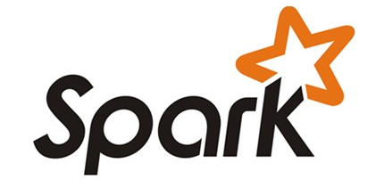

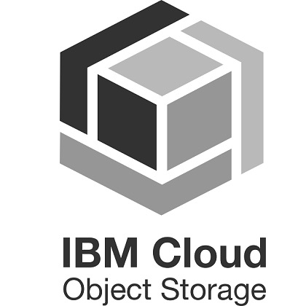
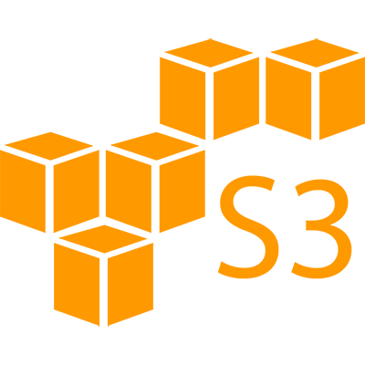

Db2 Event Store Ecosystem
Db2 Event Store
IBM
Streams
Lightning fast
ingest
Deep & Real-time
Analytics
Shared storage
IBM Community Day / Oct. 11, 2018 / © 2018 IBM Corporation

Slide 15

Fast Data and Analytics with IBM Db2 Event Store
IBM Db2 Event Store
What is it?
In-Memory database designed for massive ingestion of event data while performing real-time analytics. Optimized for event driven data processing and analysis.
Massive data ingests > million rows per second per Node
Linear Scale of Compute and Storage
Real-time analytics (HTAP) embedded
Optimized based on BLU technology
Streamed Data Performance
Built on Spark Platform
Spark: SQL /Streaming/Analytics /Machine Learning
Supports Spark API and Native Db2 Event Store API’s
Leverage open data format
Parquet Columnar Data Format
No Vendor Lock-in for access to your data
Separation of Storage and Compute
Native Data Access For Apache Hadoop / Db2 Queries, Fluid Query / IBM BIGSQL
Developer Edition download available at no cost
Ibm.biz/Db2EventStore
IBM Community Day / Oct. 11, 2018 / © 2018 IBM Corporation

Slide 16
Understanding Data Streaming
The processing of large or unbounded sequences of data
Datasets that are too large to fit in memory or disk
Can be used to provide insights for data that never ends
Typical use cases are to provide aggregations and predictions
Usually synchronous and single threaded
Very low latency and close to real time
To understand Fast Data we must first understand traditional data streaming
IBM Community Day / Oct. 11, 2018 / © 2018 IBM Corporation

Slide 17


Lightbend FDP, killrweather & Event Store Predict Weather
Weather Stations
Raw Data
Model Serving
Model Export
Prediction

Slide 18

Streaming & Visualization…
Streaming
https://github.com/IBMProjectEventStore/db2eventstore-kafka
https://github.com/IBMStreams/streamsx.eventstore
Visualization
https://github.com/IBMProjectEventStore/db2eventstore-grafana
Full Application
https://github.com/lightbend/fdp-killrweather-event-store
IBM
Streams
IBM Community Day / Oct. 11, 2018 / © 2018 IBM Corporation
Notes:
The Market is beginning to embrace Event driven Application design to support new emerging applications that are driven by Events.
These Applications range from IoT solutions to , Payments, Logistics, Web Commerce and many more. These systems generate large volumes of “Events” which need to be handled in real time and historically.
These applications ae more flexible and Adaptable to new Business requirements which enable them the easily scale and change with changing business needs over time.
Thy are being built on new Elastic Scale application platforms using micro services and while these enable the applications to scale the Database Needs to scale also and provide not only operational scale and performance but real time Analytics also.

Slide 19
demo
IBM Community Day / Oct. 11, 2018 / © 2018 IBM Corporation

Slide 20
Lightbend FDP, killrweather & Event Store Predict Weather
Weather Stations
Raw Data
Model Serving
Model Export
Prediction

Slide 21
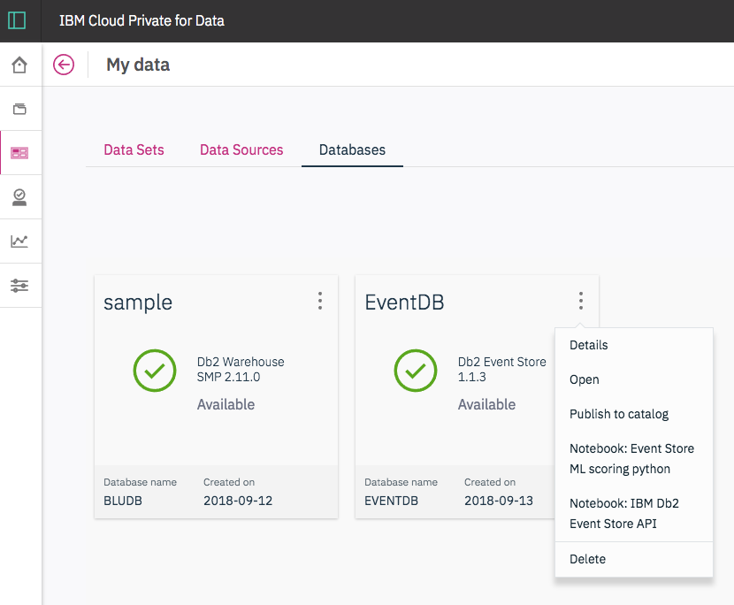
IBM Db2 Event Store in IBM Cloud Private for Data
Making Fast Data Applications Simple and Scalable
Integrated delivery and management
Simple , scalable data platform
Integrated machine learning
Notes:
Lightbends Fast Data Platform now will support Db2 Event store, greatly simplifying the underlying Data Platform needed to support their scalable reactive platform for Fast Data applications.
Rather than Deploying multiple Data management Platforms in a Lambda style delivery with separate Data science and Machine Learning, IBM Db2 Event Store combines Db2’s fast Database technology and IBM’s Data Science experience to scale and ingest Fast Data at the speed of business and apply machine learning capabilities in real time to serve data and analytics to your lightbend applications as fast as it is needed. Accelerating your Fast Data projects and giving the scalability to grow with your business needs.

Slide 22



Db2 Event Store Packaging
Developer Edition
Free Download and Go edition
Great for getting started, writing your first application
Packaged with Desktop version of DSX
Runs on MacOS, Linux, Windows via Docker
Download from www.ibm.biz/eventstore
Enterprise Edition
IBM Cloud Private for Data (Add-on)
Standalone
Production level offering
Includes high availability, monitoring UI, REST API
Packaged with Watson Studio Local
Comes in 1 and 3 node installers
Docker + Kubernetes for orchestration
IBM Community Day / Oct. 11, 2018 / © 2018 IBM Corporation
Notes:
Since all data is replicated, queries can be routed to surviving nodes on node failure.
Bulk of data is in shared storage anyway, which is queriable by everyone.

Slide 23
IBM Community Day / Oct. 11, 2018 / © 2018 IBM Corporation

Slide 24
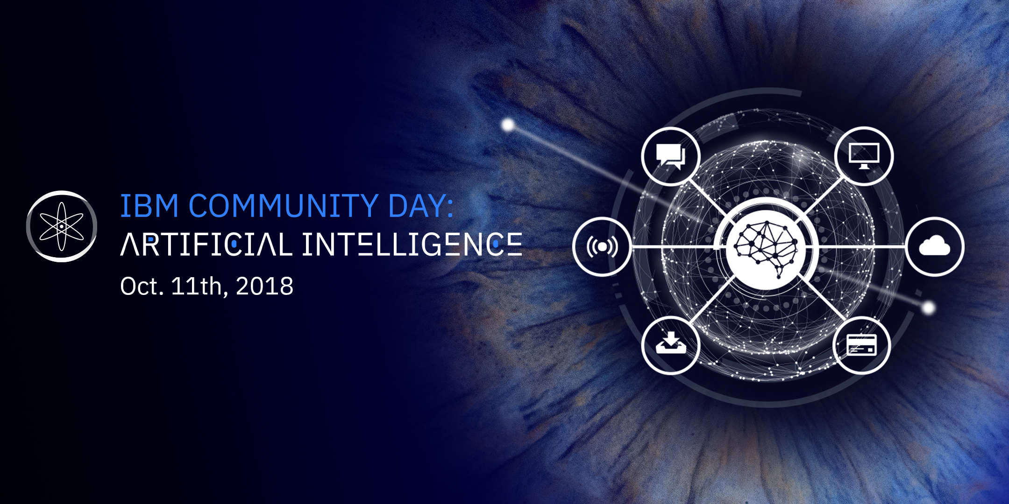
Brought to you by community.ibm.com/icpfordata Catch the replay at ibmaicommunity.bemyapp.com

Slide 25
What Is Fast Data?
The processing of high volumes of a continuous stream of data
Fast Data combines properties from traditional stream processing, big data infrastructure, and reactive applications
Low to medium latency data processing in near real time
Scales horizontally to handle a high volume of data
Stream processing is parallelized across many CPU cores and machines by partitioning the data stream
Fault Tolerance provides resilience and the ability to recover from failures
High Availability provides responsiveness and ensures uptime guarantees
IBM Community Day / Oct. 11, 2018 / © 2018 IBM Corporation

